Slide 1
MS Excel PROJECT
STOCK REPORT

Slide 2
INTRODUCTION
This project is all about the stock report of “ELECTRO Pvt .Ltd”
This project is able to record all transactions such as purchase , sale, sales returns , purchase returns…
It have column chart, pivot table , pivot chart and an userform.
Here used VBA macro and several type of functions such as vlookup , sumif for analysing data.

Slide 3

FRONT PAGE
The front page of the project is designed including company name and logo.
The logo download from google and insert into the project.
This page have a button named “START”, linked with the dashboard.

Slide 4
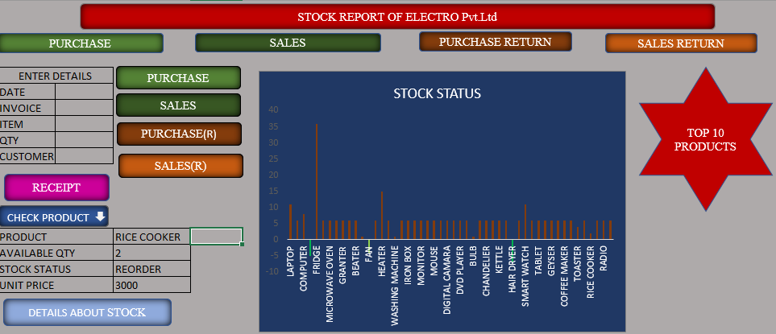
DASHBOARD
The dashboard is a comprehensive analysis of the stock of the company
There is several buttons named purchase , sales , purchase returns , sales returns. These buttons are linked with their respective sheets.
It also include a table to record all transactions of company ,here used record macro.
There is a “RECEIPT” button to provide sales receipt to customers , it linked with an another sheet.
This page have a column chart showing stock status.
There is a table to identify the stock details such as price , stock status , etc….and a button to give full details of stock it linked with another page.
Here insert a shape to identify top 10 items.

Slide 5
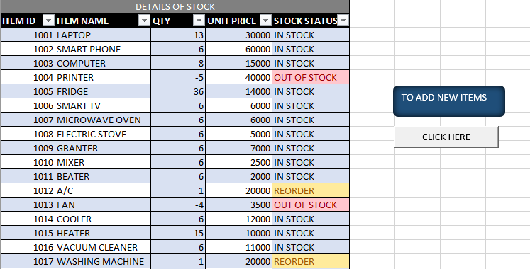
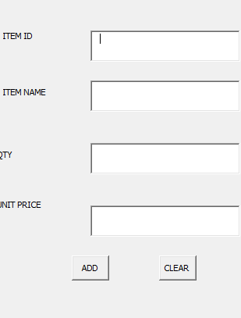
STOCK DETAILS
This page shows all details about stock such as item id, item name , qty , stock status etc…
Here used sumif function for quantity management.
There is a button for add more items into stock master. It reveals an userform to add more items.
Userform have ADD button to add items and CLEAR button to clear entered data.
There is a “HOME” button for back to dashboard.

Slide 6
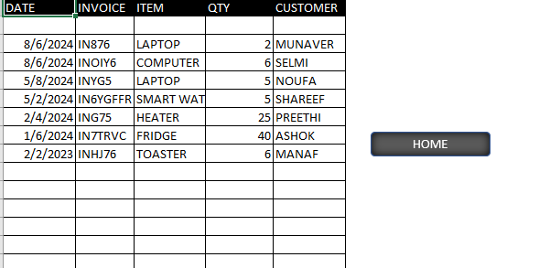
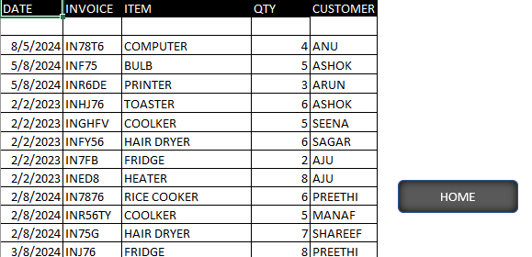
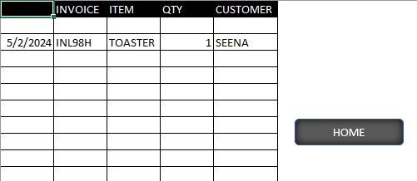
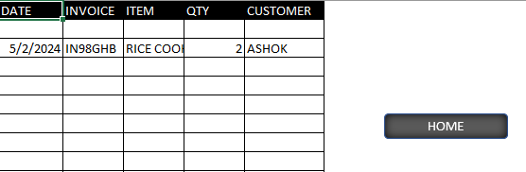

Slide 7
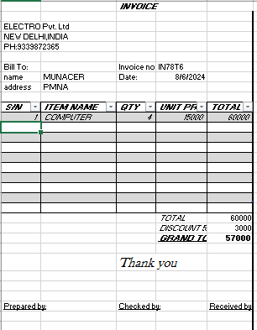
RECEIPTS
This page shows the receipts of transactions.

Slide 8
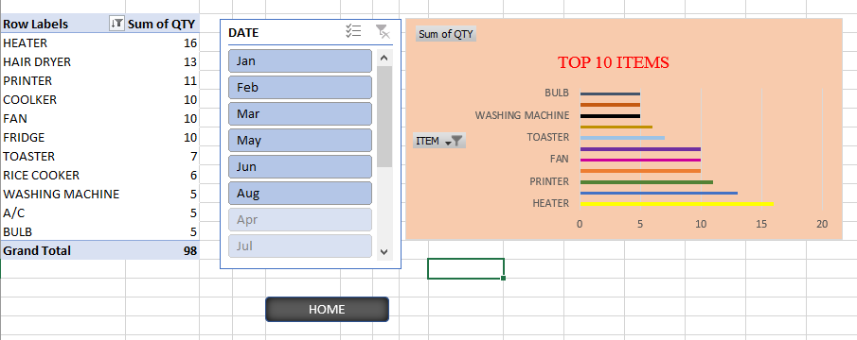
TERMINAL PAGE
The terminal page shows the top 10 items of the company by using pivot table and pivot chart.
here also have date based details by insert slicer.
There is a button “HOME” for back to dashboard.

Slide 9
THANK YOU

